Slide 1

Understanding Infrastructure Dependency in Blockchain Ecosystem
PhD Qualification Exam
Wei Xu
Committee: Mai Zheng, Henry J Duwe, Goce Trajcevski
Department of Electrical Engineering
Notes:
Put committee members or advisor

Slide 2
Outline
Motivation
Background
Methodology
Prototype and preliminary results
Discussion & Future work

Slide 3
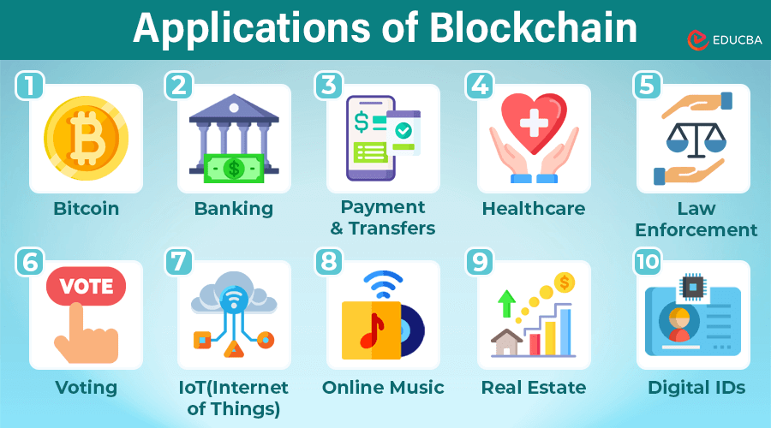
Motivation
Blockchain is promising in many use cases:
https://www.educba.com/applications-of-blockchain/
Notes:
Add a key message here: Blockchain is important and promising
Dig deeper, why they used Fabric
Put the citation here

Slide 4
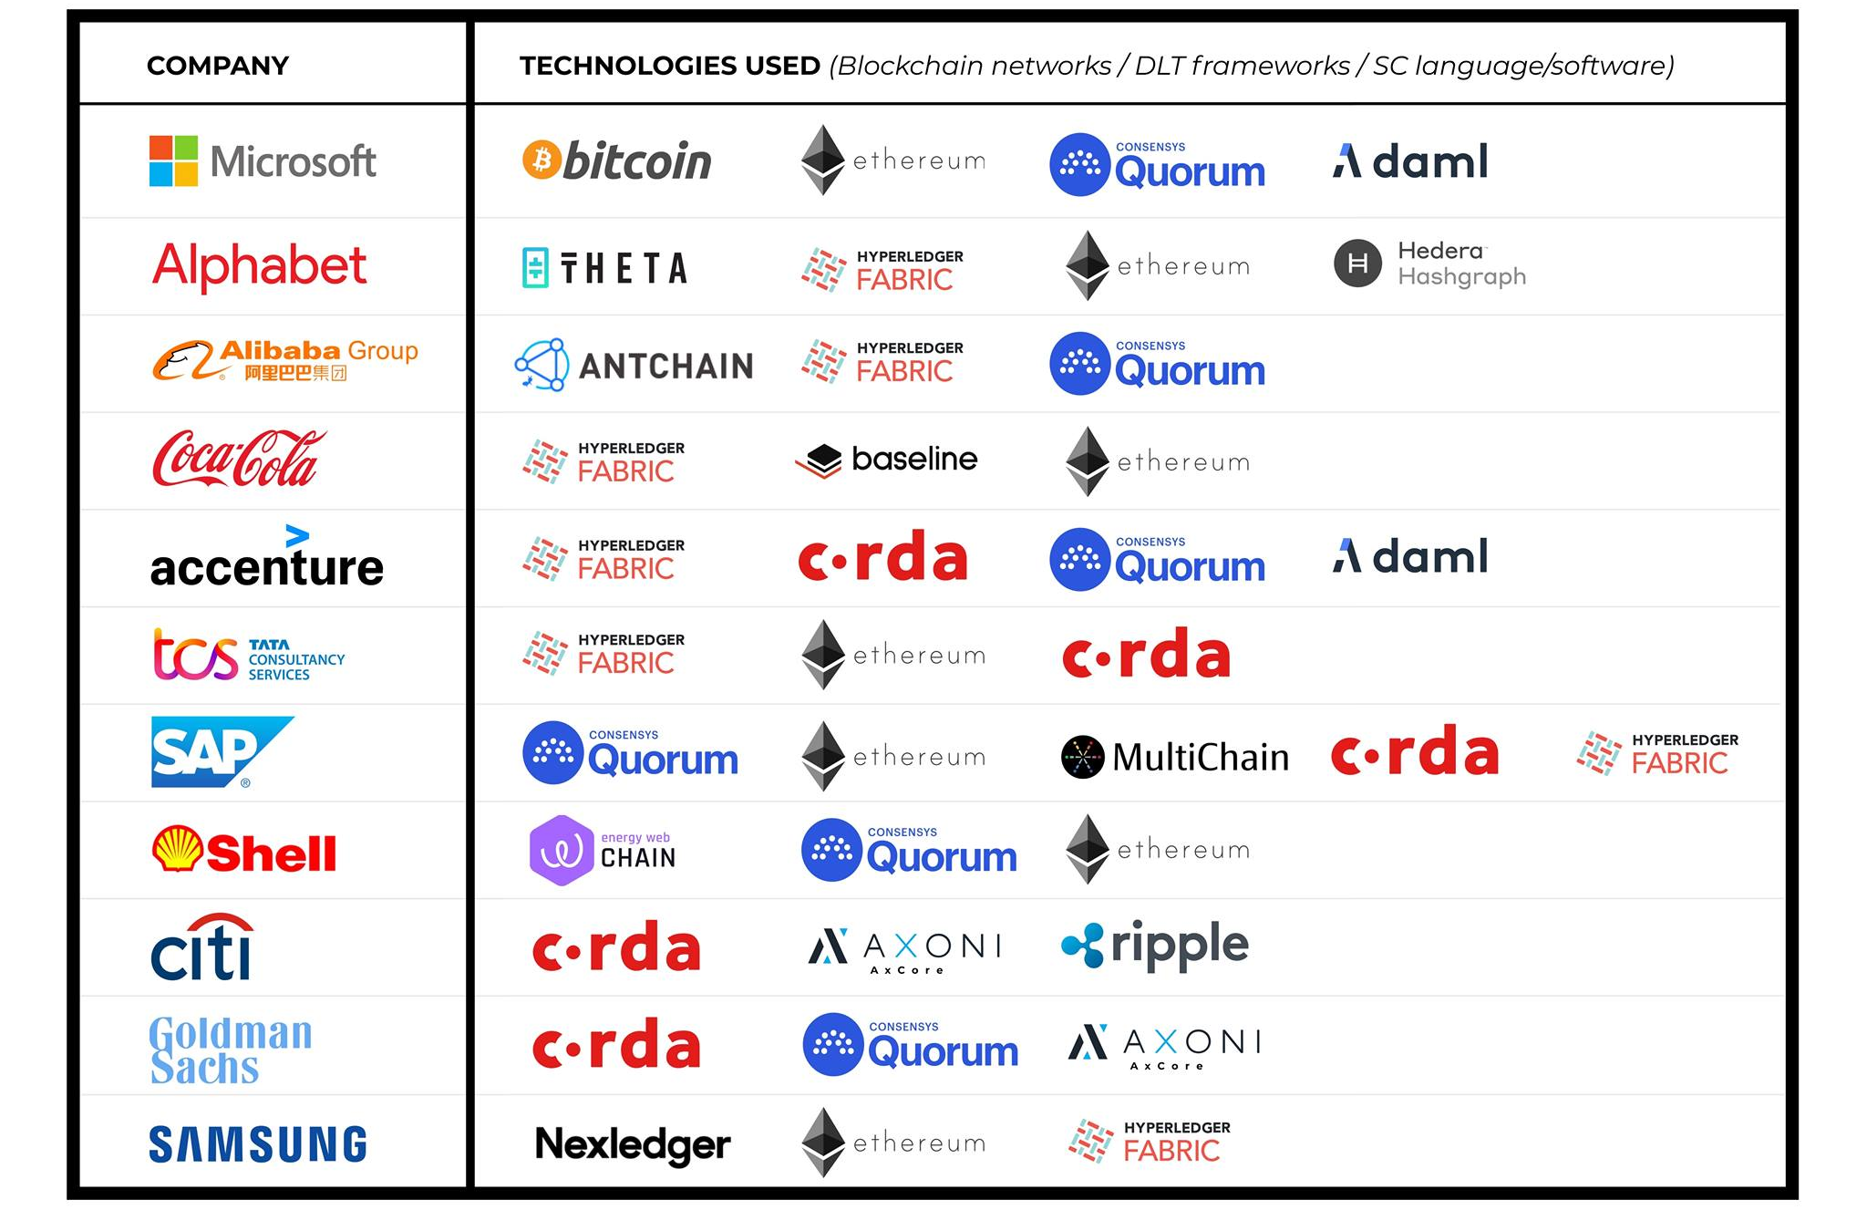
Blockchain is popular among enterprises:
https://changelly.com/blog/companies-that-use-blockchain/
Notes:
Add a key message here: Blockchain is important and promising
Dig deeper, why they used Fabric
Put the citation here
What made Fabric unique, explain Fabric is need from technical perspective

Slide 5
Motivation
Blockchain is robust thanks to the following features:
  Immutable blocks stored in chain
  Decentralized data stores
  Consensus mechanisms
  Transactions protected by cryptography
Notes:
https://www.ibm.com/think/topics/benefits-of-blockchain

Slide 6
Motivation
Blockchain is robust thanks to the following features:
  Immutable blocks stored in chain
  Decentralized data stores
  Consensus mechanisms
  Transactions protected by cryptography
But are they really this robust in practice?
Notes:
https://www.ibm.com/think/topics/benefits-of-blockchain

Slide 7
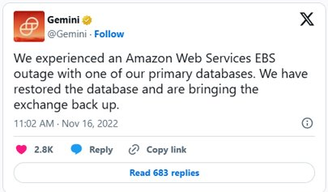
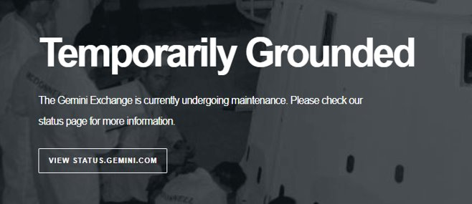
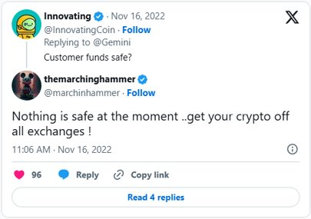
Motivation
Examples of real-world problems
  Case 1: Crypto exchange Gemini down in November 2022
    Caused by AWS EBS outage with one of the primary databases
Notes:
https://finance.yahoo.com/news/crypto-exchange-gemini-suffers-485m-234234084.html?guccounter=1&guce_referrer=aHR0cHM6Ly93d3cuZ29vZ2xlLmNvbS8&guce_referrer_sig=AQAAAHnAciOEHpS1ivqapIcBKSXldxL7170SchE_M0h-2DiYUKyzoQIYZw5Y1ioZLpScTIZlw1smuojpzAP1_d3ZWNdqyOjNFAF7_2ANPBj3PyeISqnLnDz3hATje2vsSiy7_rOshtKNZe4R-tgczYaVDDH9jFCzxYeu4LrRQQ8HqM6o

Slide 8
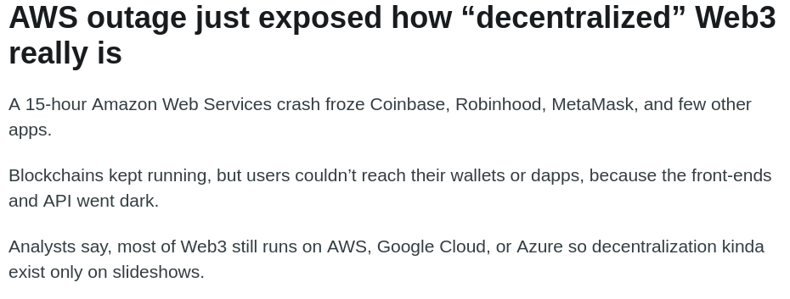
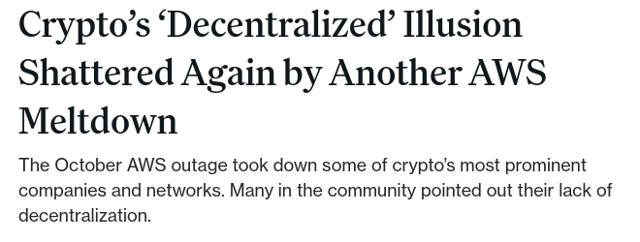
Motivation
Examples of real-world problems
  Case 2: AWS meltdown in Oct 2025 took down several major crypto companies/networks
    Caused by DNS misconfigurations and DynamoDB failure, then propagated to dependent services
Notes:
https://www.coindesk.com/news-analysis/2025/10/21/crypto-s-decentralized-illusion-shattered-again-by-another-aws-meltdown
https://medium.com/%40Alexnomads/aws-blockchain-post-mortem-report-e6c89b810f3d
Weird case
Refine the flow to make it more clear

Slide 9
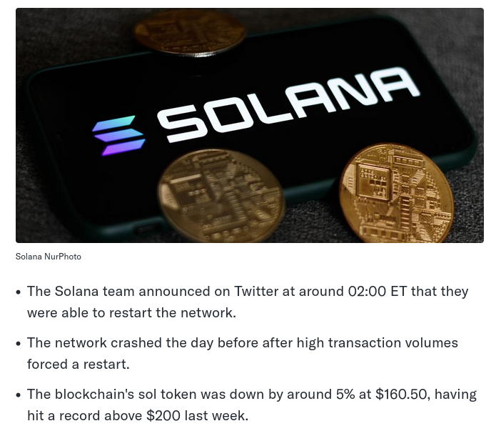
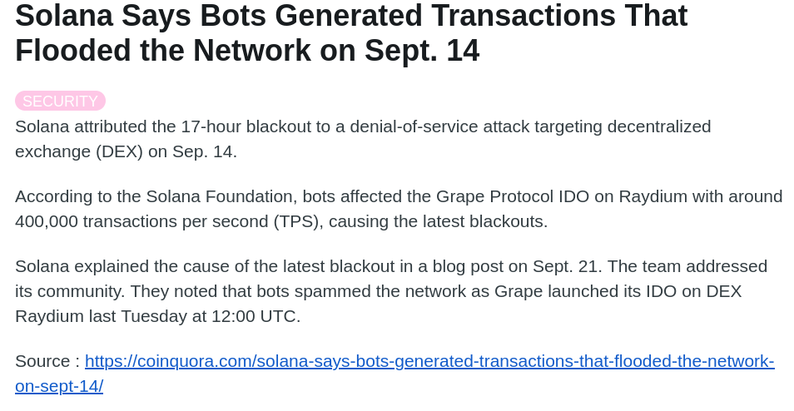
Motivation
Examples of real-world problems
  Case 3: Solana blockchain went offline in Sept 2021 after a surge of transactions
    Caused by validators overloaded by too heavy workload
Notes:
https://finance.yahoo.com/news/solana-says-back-running-surge-094958370.html
https://www.reddit.com/r/CryptoCurrency/comments/psnc05/solana_says_bots_generated_transactions_that/
Mention this in the speech that failure events are due to different reasons

Slide 10
Motivation
Examples of real-world problems
  Case 3: Solana blockchain went offline in Sept 2021 after a surge of transactions
    Caused by validators overloaded by too heavy workload
Blockchains are highly dependent on their underlying infrastructures!
We need to understand the blockchain dependency to ensure E2E robustness and performance implication
Notes:
https://finance.yahoo.com/news/solana-says-back-running-surge-094958370.html
https://www.reddit.com/r/CryptoCurrency/comments/psnc05/solana_says_bots_generated_transactions_that/

Slide 11
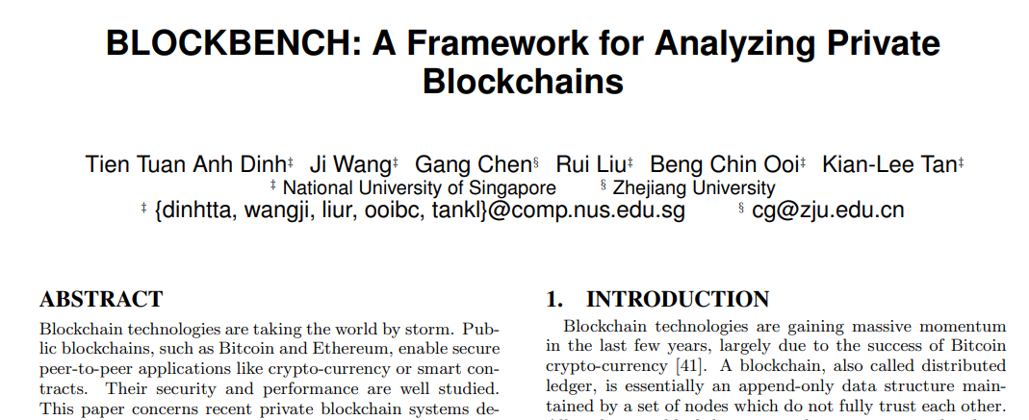
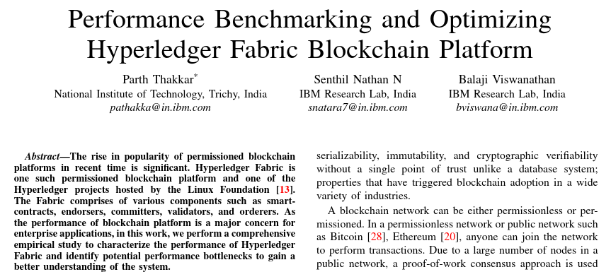
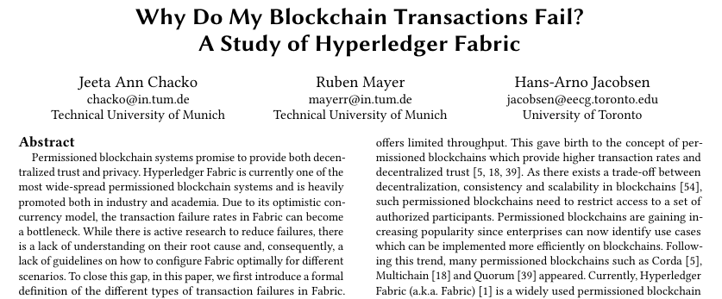
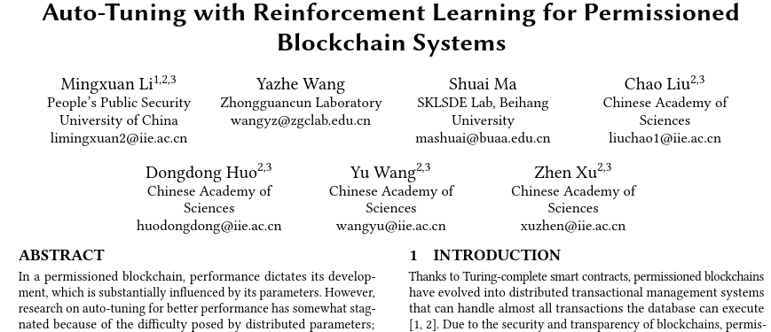
Limitations of the state of the art
Related works:
  Proposed the first benchmarking systems for private blockchains (Tien et al.@SIGMOD'17)
  Observed some configurable parameters and introduced simple optimizations. (Thakkar et al.@MASCOTS'18)
  Classified transaction failures, developed a benchmarking system, and observed dependency between block size and failures. (Chacko et al.@SIGMOD'21)
  Proposed an auto-tuning system for performance optimization and filtered out some important configuration parameters for auto-tuning efficiency. (Li et al.@VLDB'23)
Notes:
Put blockbench paper here
Red block at the rigth to deliver

Slide 12
Limitations of the state of the art
Do not consider cross layer dependencies
  Only focused on a limited number of configurable options in an application/blockchain layer
  Did not consider system behavior under abnormal scenarios
Notes:
Directly go to limitations

Slide 13
Limitations of the state of the art
Do not consider cross layer dependencies
  Only focused on a limited number of configurable options in an application/blockchain layer
We need a framework to study the blockchain dependency on infrastructure conveniently and thoroughly
Notes:
Directly go to limitations

Slide 14
Outline
Motivation
Background
Methodology
Prototype and preliminary results
Discussion & Future work

Slide 15
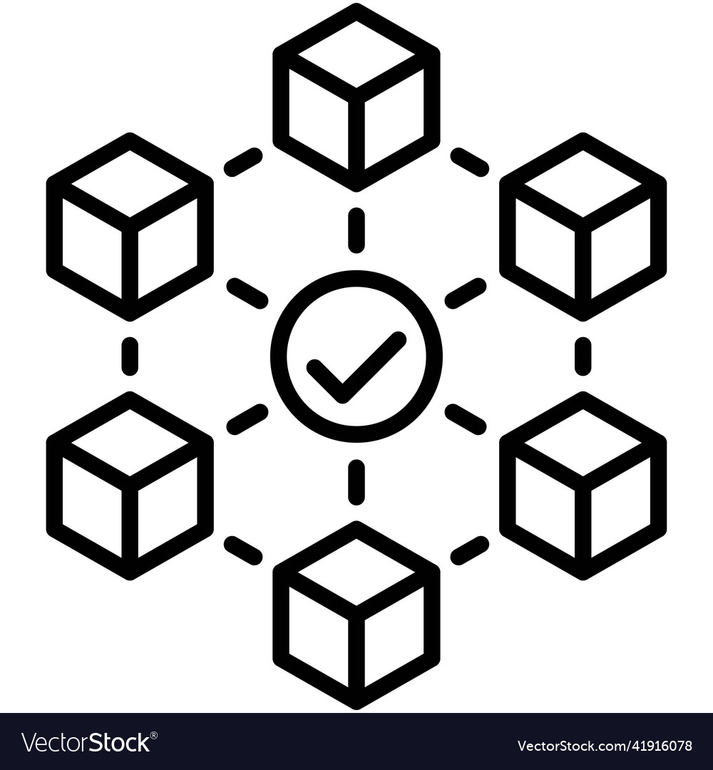
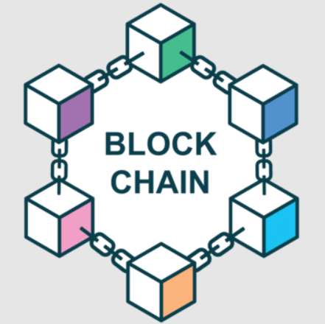
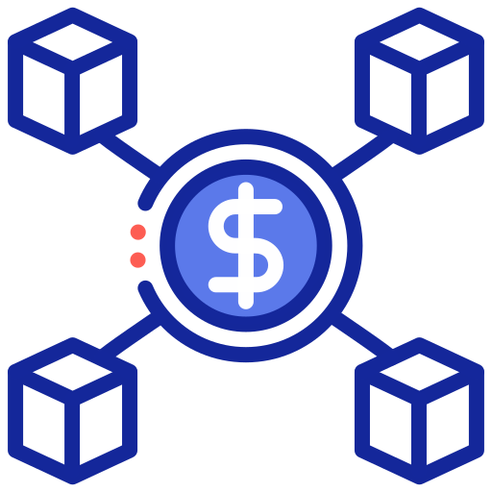
What is blockchain
An immutable transaction ledger, maintained within a distributed network of nodes
How does blockchain works?
  Nodes validate transactions by a consensus protocol
  Transactions grouped into blocks connected as a chain by hash
  Each node (peer) maintains a copy of the ledger and the blocks
Notes:
https://www.researchgate.net/profile/Siamak-Solat/publication/349537863_Permissioned_vs_Permissionless_Blockchain_How_and_Why_There_Is_Only_One_Right_Choice/links/64ea6a700453074fbdb663ef/Permissioned-vs-Permissionless-Blockchain-How-and-Why-There-Is-Only-One-Right-Choice.pdf

Slide 16
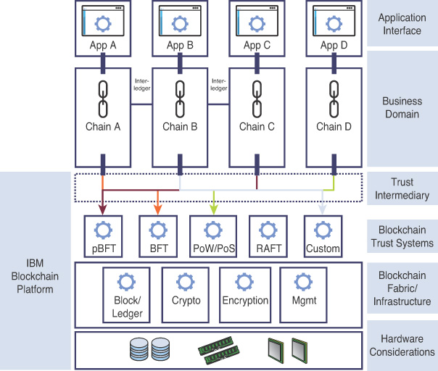
What is Blockchain ecosystem
Blockchain is not a standalone application, relies on a complex infrastructure to run.
  e.g., IBM blockchain infrastructure
  Lots of config parameters
  Configuration decides infrastructure
Blockchain system behavior depends on ecosystem configurations
https://www.informit.com/articles/article.aspx?p=2955143
Notes:
https://www.informit.com/articles/article.aspx?p=2955143&seqNum=2
Add a title to this figure (e.g., IBM blockchain system)
Move this slide to BG section

Slide 17
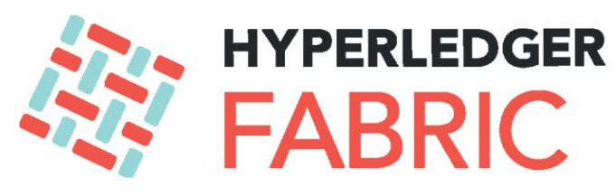
What is Hyperledger Fabric
Open-sourced, enterprise-grade distributed permissioned ledger platform
Features:
  E-O-V architecture that separates execution from consensus
  No dependency on concurrencies
  Policy-based endorsements
  Extensible blockchain for running distributed applications
Notes:
https://www.ibm.com/think/topics/hyperledger
https://dl.acm.org/doi/pdf/10.1145/3190508.3190538
What is the purpose of separating execution from consensus?
Put some company icons here to show its popularity

Slide 18
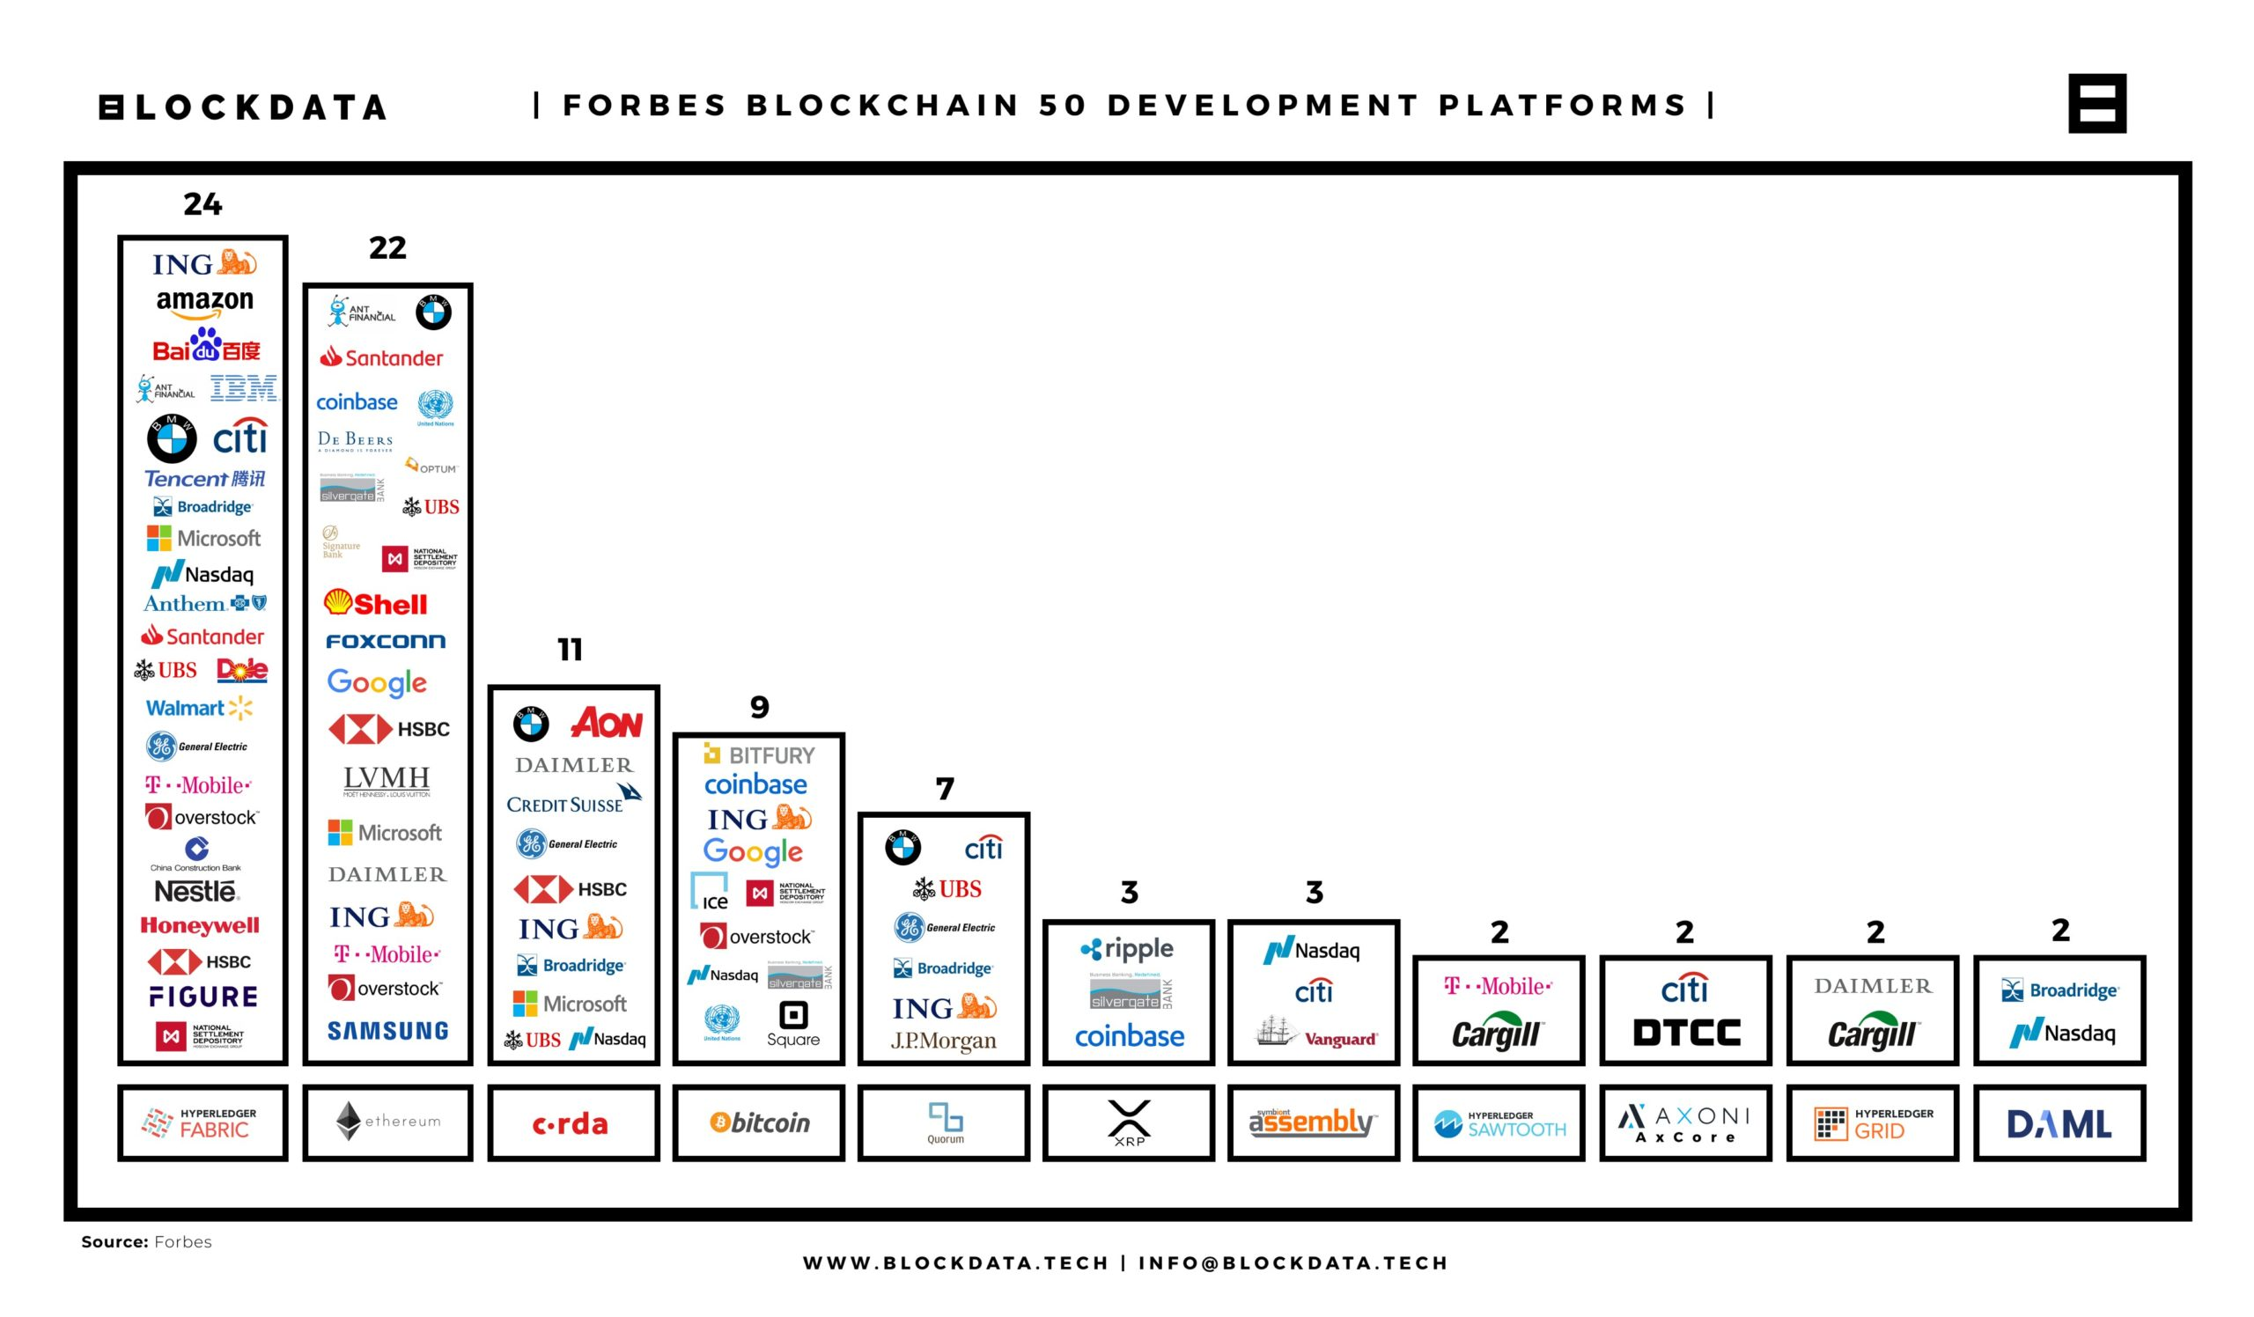
Why Hyperledger Fabric
"Unofficial standard for enterprise blockchain platform" -IBM
https://medium.com/blockdata/forbes-blockchain-50-data-deep-dive-117fc230822f
Notes:
Mention this is a starting point
Forbes Blockchain 50 Data Deep Dive | by BLOCKDATA | Blockdata | Medium

Slide 19
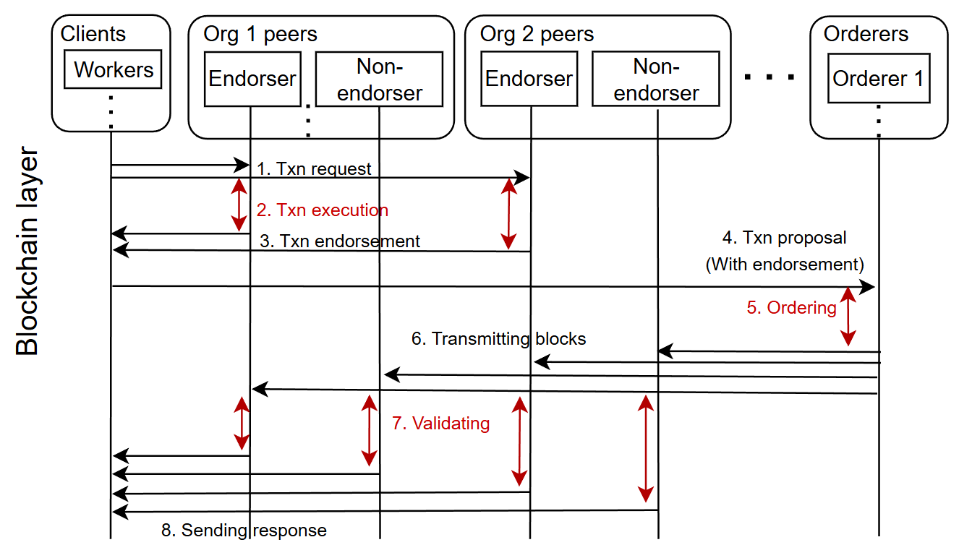
Hyperledger Fabric Transaction workflow
Notes:
Mention Org= enterprise can be one company, provide some context
Mention what one transaction can be, like making a bank transaction and alter what is stored in the ledger

Slide 20
Outline
Motivation
Background
Methodology
Prototype and preliminary results
Discussion & Future work

Slide 21
Methodology
Research Goal:
  Close the gap of comprehensive understanding about blockchain dependency on infrastructure
    Dependency on infrastructure configuration
    Performance metrics under different scenarios
      Normal conditions with different configurations
      Abnormal conditions with different faults

Slide 22
Methodology
Research Goal:
  Close the gap of comprehensive understanding about blockchain dependency on infrastructure
    Dependency on infrastructure configuration
    Performance metrics under different scenarios
      Normal conditions with different configurations
      Abnormal conditions with different faults
We propose blockchain controller framework, BlockController
  Automatic test network provisioning
  Infrastructure configuration and refined benchmarking
  Easy resource allocation
Notes:
abnormal conditions with diff faults
Like one peer is down, what will happen?

Slide 23
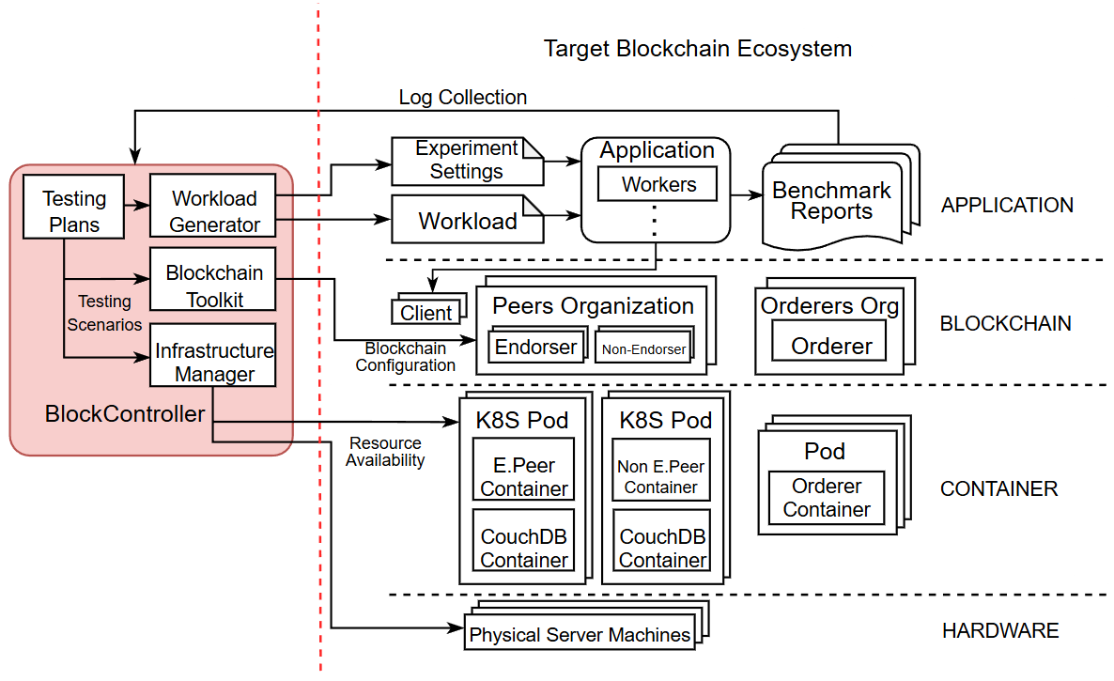
Architecture
Notes:
Kubernetes based testbed
What we can do using this testbed, like a control framework
Add boxes at side
Different ways to pick configurations, possible way to prioritize configurations (random, Myra's work, domain knowledge), configuration selector

Slide 24
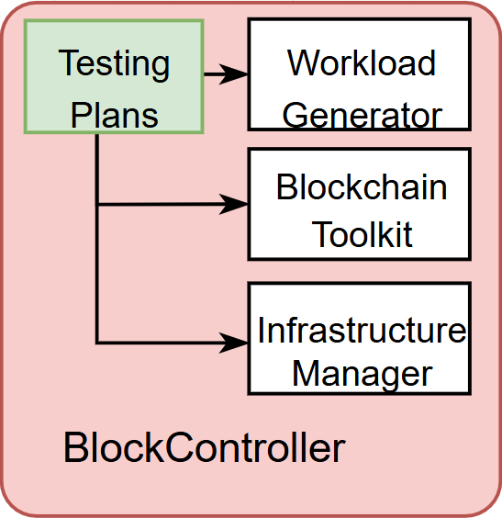
Testing Plans
Decide the direction of configurations
Provide testing scenarios to simulate possible use cases:
  Supply chain, healthcare, banking…
Provide high level information like:
  How many organizations/peers/endorsers… in the blockchain
  What endorsement policy
  Hardware resource assignment
  What fault to inject (Extension of the current fault injection framework)
    Not only statedb faults
    Which layer has fault?
    What component has fault?
    Cross layer faults?
The “Decision maker” of the framework
Notes:
Some tools to given different tps, automatically choose a proper combination of configuration to achieve appropriate performance
Strategy to navigate all combinations
Some specific examples how to define a policy/scenario
Start some randomly values first, there might be dependencies between them, try based on domain knowledge so far
Scenarios to emphasize
Recommendation to optimize for next steps
Consider the config policy as the "end product"
Testing scenarios, some strategy to pick scenarios

Slide 25
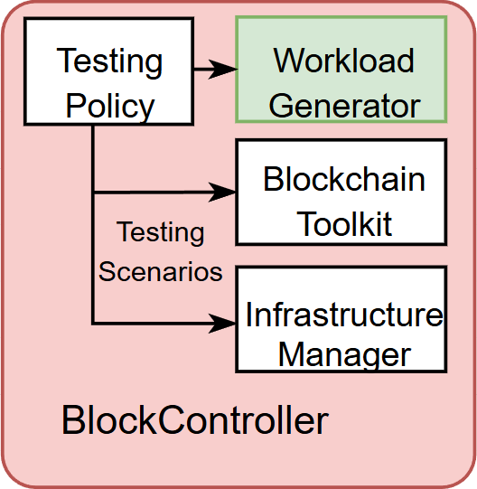
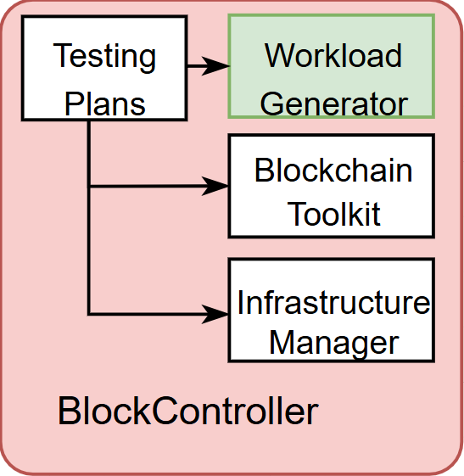
Workload generator
Execute workload configurations
Configurable parameters:
  Number of workers
  Number of assets
  Transaction arrival rate
  Read or Write operations
Automatic log recording and better statistics

Slide 26
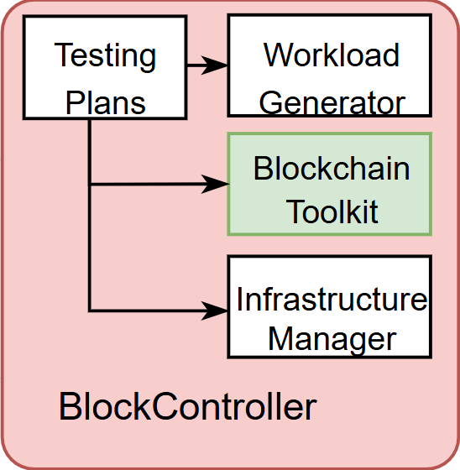
Blockchain Toolkit
Easy blockchain network provisioning
Automatic configuration (Decision made in Testing Plans) including the following:
  Number of peers and their roles
  Number of organizations
  Endorsement policy
  Block size
  Consensus algorithm (RAFT, BFT)

Slide 27
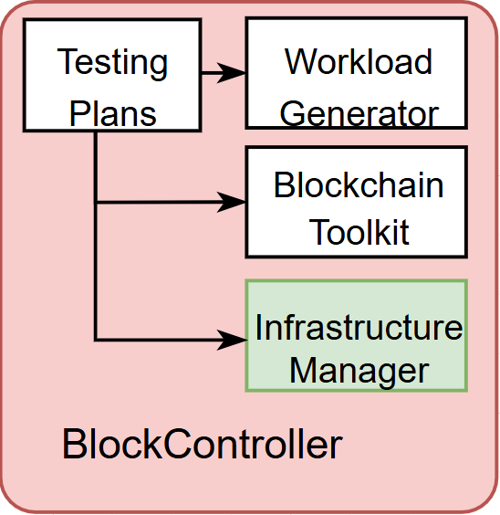
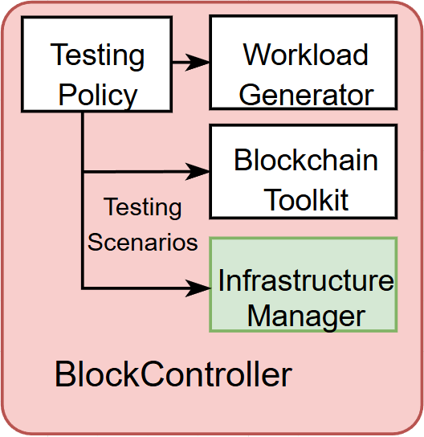
Infrastructure Manager
Ensure resource availability to both container layer and hardware layer
  Automated resource allocation to each individual container and Kubernetes pod
  Automatically assigning distinct roles to specific node
  Straightforward application of container changes
  Inject faults to different components
Notes:
Extend the fault injection framework to more componentsother than CouchDB related parts?
More error patterns? (Other than error codes)
More involved components? (Orderers)
More cross layer faults?
New contribution: Consider resource constraint, imbalanced resource allocation, infra allocation strategy
Identify some opportunities to tune the configuration to improve allocation/overall performance
Expose the gap, giving the same amount of resource
Survey some resource utilization related works
Fail stop, fail slow
Design the allocation plan
Some phases, different phases may be sensitive to resource allocation
Hypothesis? RQ? Design experiments to answer those questions
Be consistent regarding the experiments (setup, scale)
Keep finding: Motivation, find some performance degradation cases, ntwk congetion, performance bottleneck
Good answers to "Why fabric?"

Slide 28
Outline
Motivation
Background
Methodology
Prototype and preliminary results
Discussion & Future work

Slide 29
Preliminary prototype setup
4 inter-connected Dell Poweredge d430 nodes on Cloudlab
  Two 2.4 GHz 64-bit 8-core Xeon E5-2630v3 processors
  64 GB DDR4 RAM (8 x 8 GB modules)
  200 GB 6Gbps SATA SSD, 2 x 1 TB 7200 RPM 6 Gbps SATA disks
Node list:
Node name | Role
node0.d430.isu-cloud.emulab.net | Control plane
node1.d430.isu-cloud.emulab.net | Org1 pods (Endorser, Non-endorser)
node2.d430.isu-cloud.emulab.net | Org2 pods (Endorser, Non-endorser)
node3.d430.isu-cloud.emulab.net | Org0 pods (Orderer)

Slide 30
Preliminary prototype setup
Implemented some functionalities in Blockchain Toolkit and Infrastructure Manager, including:
  Automatic network provisioning
  Endorser peer enrollment
  Easy hardware resource allocation
  Fault injection in container level
Results: Performance under different scenarios

Slide 31
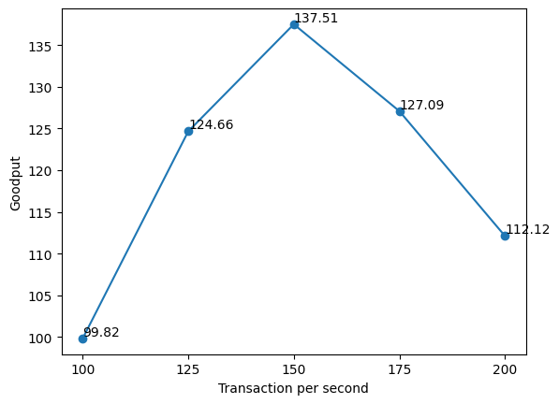
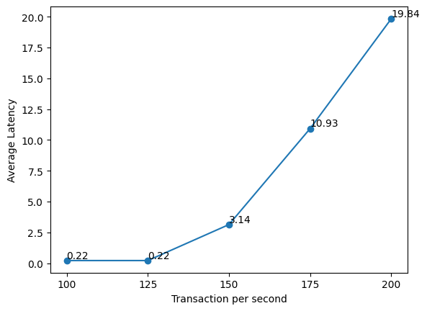
Preliminary experiments:
Normal Scenario
Different configurations may lead to greatly changed performance
  When changing the TPS, the throughput can increase by 37.76%
  The performance change is not linear
    Throughput decrease by 18.46%
Notes:
Have some scripts to setup the cluster
Avoid using "tune"
Different config lead to greatly changed performance, not linearly
Affect throughput by what percentage

Slide 32
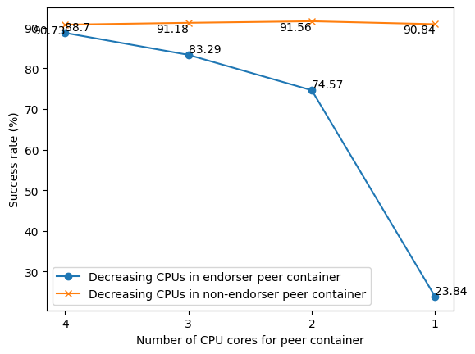
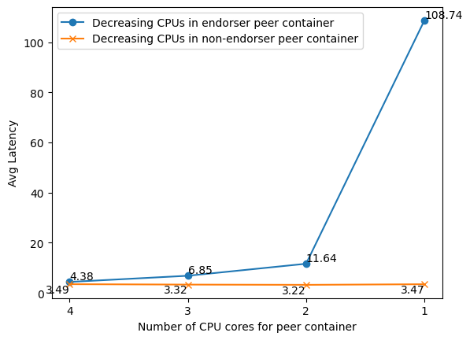
Preliminary experiments
Normal Scenario
Different impacts when different amount of resource assigned to endorsers and non-endorsers
Notes:
Describe the colors, x axis... first, describe the general trend
Describe why this is the case

Slide 33
Preliminary experiments
Normal Scenario
Different impacts when different amount of resource assigned to endorsers and non-endorsers
Observation: Fabric transaction performance is very sensitive to endorser peers' computing power!
Notes:
Describe the colors, x axis... first, describe the general trend
Describe why this is the case

Slide 34
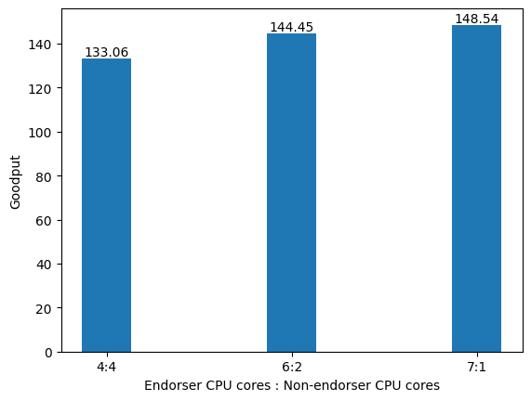
Preliminary experiments
Normal Scenario
Keep overall CPU cores the same, distribute them unequally to endorsers and non-endorsers
Peer container baseline configurations
CPU cores (non-endorsing peer container) | 4
CPU cores (endorsing peer container) | 4
RAM (non-endorsing peer container) | 8 GB
RAM (endorsing peer container) | 8 GB
Notes:
Show the initial results here

Slide 35
Preliminary experiments
Normal Scenario
Assign 2 more cores to endorser, lead to 8.56% more goodput
8.56%
Peer container baseline configurations
CPU cores (non-endorsing peer container) | 2
CPU cores (endorsing peer container) | 6
RAM (non-endorsing peer container) | 8 GB
RAM (endorsing peer container) | 8 GB
Notes:
Show the initial results here

Slide 36
Preliminary experiments
Normal Scenario
Assigning more cores to the endorser peer, the goodput almost reached the target TPS=150, with 11.63% more goodput
8.56%
11.63%
Peer container baseline configurations
CPU cores (non-endorsing peer container) | 1
CPU cores (endorsing peer container) | 7
RAM (non-endorsing peer container) | 8 GB
RAM (endorsing peer container) | 8 GB
Notes:
Show the initial results here

Slide 37
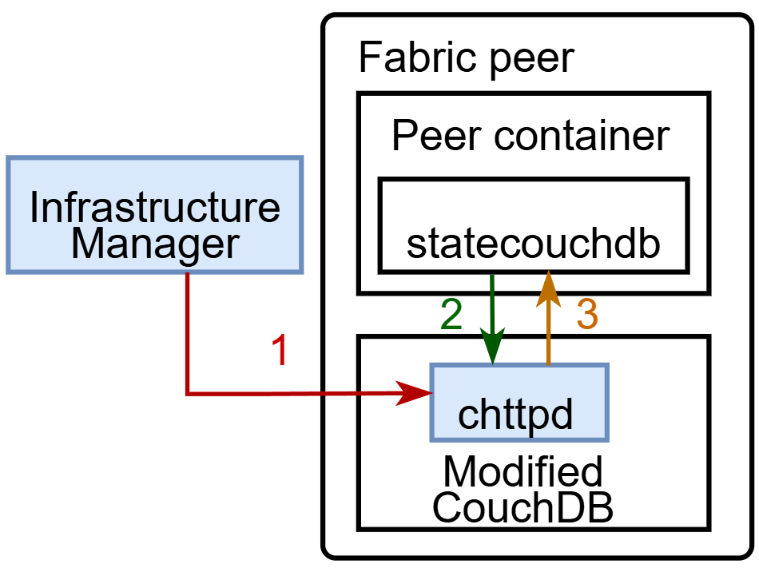
Preliminary experiments
Abnormal Scenario
Inject a fault in the CouchDB container to measure performance metrics under abnormal scenarios
Send HTTP request to CouchDB to "switch on" the implemented faulty code.
CouchDB receives the request from peer.
CouchDB returns the implemented error message, instead of processing it correctly.
Notes:
The red arrow should be coming from the blockchain toolkit

Slide 38
Preliminary experiments
Abnormal Scenario
Two error codes tested: 404 and 500
How to trigger:
  Create the test-network using the modified CouchDB and Fabric container
  Send HTTP request to CouchDB to toggle the error
  Let CouchDB receive normal requests from the Fabric
Result:
  The peer which receives the injected fault from the CouchDB failed to join the blockchain network
  Transactions cannot complete at all

Slide 39
Outline
Motivation
Background
Methodology
Prototype and preliminary results
Discussion & Future work

Slide 40
Conclusion
Designed the BlockController framework for blockchain dependency study
  Enables fast multiple levels' configuration and integrated with benchmarking
  Easy resource management
Notes:
Figure out:
ANother hardware resource bottleneck: Storage bandwidth, network IO, anything we're missing
Possible directions: Testing policy and Infrastructure oriented (Fault tolerance)
First performance paper, consider some possible outcomes, understanding dependency/performance implication
Different availability of resources, how other infra level config may change or even invalidate related works’ results
A Study of Database Performance Sensitivity to Experiment Settings
(Check follow up work, compare their figures, discuss this paper in tomorrow’s meeting)
Next based on this, optimization or extend to other blockchains

Slide 41
Future work
Make the BlockController more "generic"
Understand how each knob works, how these parameters change the performance
Focus more on infrastructure
  Reason: Infrastructure level change is less explored
Investigate conflicts among different validators sharing hardware resource
  Understand the conflicts → Mitigate the conflicts
Start with existing setups (Related works)
  See if their conclusion can still hold with changing configurations in infrastructures.

Slide 42
Future work (cont'd)
Explore bottlenecks
  e.g., What part of the infrastructure may become bottleneck, What case will exhaust hardware resource
  Research questions like "When the infrastructure can be bottleneck/underutilized"
Explore resource unavailability
  Performance/System behavior under abnormal cases
  Example: Network partition as an extreme case of availability issue
    Need larger scaled testbeds

Slide 43
Outline
Motivation
Background
Methodology
Prototype and preliminary results
Discussion & Future work

Slide 44
THANK YOU! & QUESTIONS?

Slide 45
Baseline Configurations – Application layer
Benchmark layer baseline configuration
Number of workers | 10
Number of assets each worker creates | 500
Transaction Duration (sec) | 600
Transaction send rate | 100 TPS
Read:Update ratio in workload | 0% Read, 100% Update

Slide 46
Baseline Configurations – Blockchain layer
Blockchain layer baseline configurations
Fabric version | 2.5
Chaincode | asset-transfer-basic
StateDB | CouchDB
totalQueryLimit | 100000
MaxMessageCount | 500
AbsoluteMaxBytes | 10 MB
Number of Organizations | 3
Number of peers per Organization | 2
Number of endorsers per Organization | 1

Slide 47
Conclusion & Future work
Designed the BlockController framework for blockchain dependency study
  Enables fast multiple levels' configuration and integrated with benchmarking
  Easy resource management
Timeline for the future works
  Late Dec: Workload classification based on typical use cases
  Jan 2026: Simplified fault injection process and corresponding error cases
  Feb 2026: Better peer configuration/scaling
  May 2026: Automated configuration optimization (Examples: LLM or other tools, etc)
  And then: Extend the framework to other blockchains
Notes:
Figure out:
ANother hardware resource bottleneck: Storage bandwidth, network IO, anything we're missing
Possible directions: Testing policy and Infrastructure oriented (Fault tolerance)
First performance paper, consider some possible outcomes, understanding dependency/performance implication
Different availability of resources, how other infra level config may change or even invalidate related works’ results
A Study of Database Performance Sensitivity to Experiment Settings
(Check follow up work, compare their figures, discuss this paper in tomorrow’s meeting)
Next based on this, optimization or extend to other blockchains

Slide 48
Baseline Configurations – Kubernetes Layer
Kubernetes layer baseline configurations
CPU cores assigned to non-endorsing peer container | 5 cores
CPU cores assigned to endorsing peer container | 5 cores
RAM assigned to non-endorsing peer container | 5 GB
RAM assigned to endorsing peer container | 5 GB
Total number of CPU cores assigned to endorsing peer | 10 cores
Total size of RAM assigned to endorsing peer | 10 GB
Total number of CPU cores assigned to non-endorsing peer | 10 cores
Total size of RAM assigned to non-endorsing peer | 10 GB

Slide 49
Baseline Configurations – Hardware layer
Hardware layer baseline configuration
Total number of CPU cores per machine | 16
CPU base speed | 2.4 GHz
RAM size per machine | 64 GB
Storage medium | 1 SATA SSD, 2 HDDs
Total disk space | 2200 GB
Number of drives | 3
Bandwidth | 941 Mbits/sec

Slide 50
Initial testbed implementation
  Preliminary controller module to provision resources
  Policy is based on domain knowledge
  Describe fault injection module (In Jobayer's project)
  Performance measurement and fault injection experiments
    Show different results in these two parts

Slide 51
Methodology
Research Goal:
  For different configurations in different layers, examine what kind of impact that tuning each parameter will bring to the performance.
  (Cover the dependency, refer to the SIGMOD paper, be more specific)
How to measure the performance:
  Metrics:
    Goodput (Effective throughput)
    Success rate
    Latency (Max, Min, Avg)
    Types of transaction errors and their percentage
Solution: E2E testbed for better dependency studies

Slide 52
Motivation
What makes blockchain popular
Just tell why ppl like it/Show blockchain is robust
Don't ask question in the first point, show common beliefs that ppl believe blockchain is secured, immutable
  Enhanced security
  Increased efficiency and speed
  Automation Don’t show irrelevant things here
  Show ppl assume blockchain is stable
But are they really robust enough?
  Show a box like future slides
Notes:
https://www.ibm.com/think/topics/benefits-of-blockchain

Slide 53
Preliminary experiments
Optimize performance
When the TPS=150, goodput reached max value 137.51
  Strategy: Assign more CPU cores to endorser peer, less CPU cores to non-endorser peers
Peer container baseline configurations
CPU cores (non-endorsing peer container) | 4
CPU cores (endorsing peer container) | 4
RAM (non-endorsing peer container) | 8 GB
RAM (endorsing peer container) | 8 GB
Peer container baseline configurations
CPU cores (non-endorsing peer container) | 2
CPU cores (endorsing peer container) | 6
RAM (non-endorsing peer container) | 8 GB
RAM (endorsing peer container) | 8 GB
Resource
Manager

Slide 54
Methodology
How to do the experiments?
What's the challenge in here?
  Configuration space is huge (Put early in the motivation)
    Identify some important configurations
  Need to have justification
  A problem to how to config the blockchain
  Machine learned tuning
  LLM AI agents to tune
    Before doing this, we need some understanding on different impacts
    Logic chain
    Update the motivation part as well
  Describe what we have done
Notes:
https://arxiv.org/pdf/2510.25017
Why we picked some parameters, instead of picking some random parameters to test

Slide 55
Other existing challenges keep it backup slide
Configuration space too huge
  Hard to find the important configurations
  "The performance boost observed by tuning Fabric parameters is merely the tip of the iceberg" (Li et al.@VLDB'23)
Configurating parameters is inconvenient
  Configuration files scattered at many places
  Inefficient to configure manually
    Existing auto-tuning solutions also cannot cover cross-layer dependencies

Slide 56
Other existing challenges
Configuration space too huge
  Hard to find the important configurations
  "The performance boost observed by tuning Fabric parameters is merely the tip of the iceberg" (Li et al.@VLDB'23)
Configurating parameters is inconvenient
  Configuration files scattered at many places
  Inefficient to configure manually
    Existing auto-tuning solutions also cannot cover cross-layer dependencies
How to automatically apply configurations while cover the dependencies?

Slide 57
Discussions & Future work
Timeline for the future works
  Some other configuration dependency works
  Cite papers about hadoop, OpenStack, Tabassum's work (Check slack)
  Complete implementation of the full FabricController framework
  Simpler fault injection and corresponding
What do expect to finish

Slide 58
Methodology
What is implemented in FabricBlockController:
  Easy test network provisioning using ansible
  Simplified test network recreation
  Simplified resource managing for containers
  Log recording for benchmarking results
  Injected statedb fault
Describe each component one by one
  Checkout runzhou's IO slides
  Merge fault injector with resource manager

Slide 59
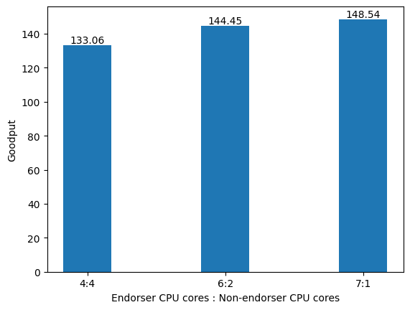
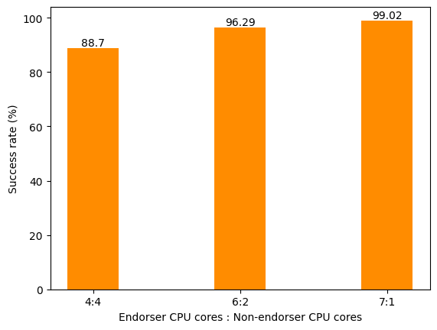
Preliminary experiments
Hardware resource allocation
Applying the resource manager module...
Show the main message/finding here, summarize them here

Slide 60
What is blockchain
An immutable transaction ledger, maintained within a distributed network of nodes
How does blockchain works?
  Nodes validate transactions by a consensus protocol
  Transactions grouped into blocks connected as a chain by hash
  Each node (peer) maintains a copy of the ledger and the blocks
Two kinds of blockchain: Permissionless and Permissioned
  Permissionless: Everyone can join without permission
  Permissioned: Every participant must be verified to join
Notes:
https://www.researchgate.net/profile/Siamak-Solat/publication/349537863_Permissioned_vs_Permissionless_Blockchain_How_and_Why_There_Is_Only_One_Right_Choice/links/64ea6a700453074fbdb663ef/Permissioned-vs-Permissionless-Blockchain-How-and-Why-There-Is-Only-One-Right-Choice.pdf

Slide 61
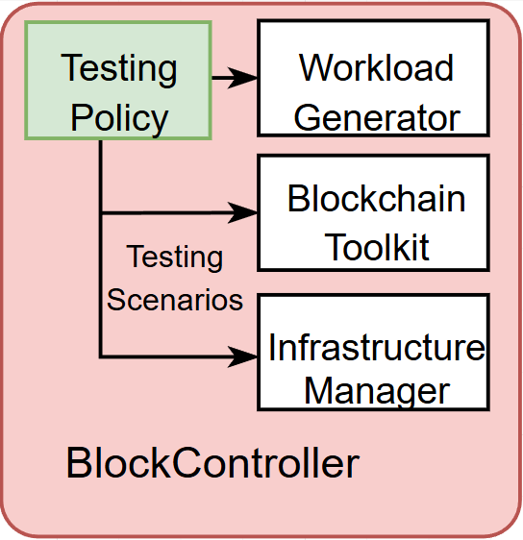
Testing Plan decision made here
Providing policies for blockchain/infrastructure configuration
Different configuration strategies based on domain knowledge:
  Highest possible throughput
  Balanced/Unbalanced blockchain
  Balanced resource allocation by reassigning hardware
Generate testing scenarios based on the strategies
Apply configuration combination based on testing scenarios
Simulate different resource, control resource/workload config to simulate different types of scenarios/different infra characteristics
Notes:
Some tools to given different tps, automatically choose a proper combination of configuration to achieve appropriate performance
Strategy to navigate all combinations
Some specific examples how to define a policy/scenario
Start some randomly values first, there might be dependencies between them, try based on domain knowledge so far
Scenarios to emphasize
Recommendation to optimize for next steps
Consider the config policy as the "end product"
Testing scenarios, some strategy to pick scenarios

